Slide 1
Supervised ML Classification Capstone Project Cardiovascular Risk Prediction by
Prajwal M V

Slide 2
Contents
Problem Statement
Data Inspection
Data Analysis
Level Encoding
Feature Selection
Handling Imbalanced Data
Implementing Algorithms
Challenges
Conclusion

Slide 3
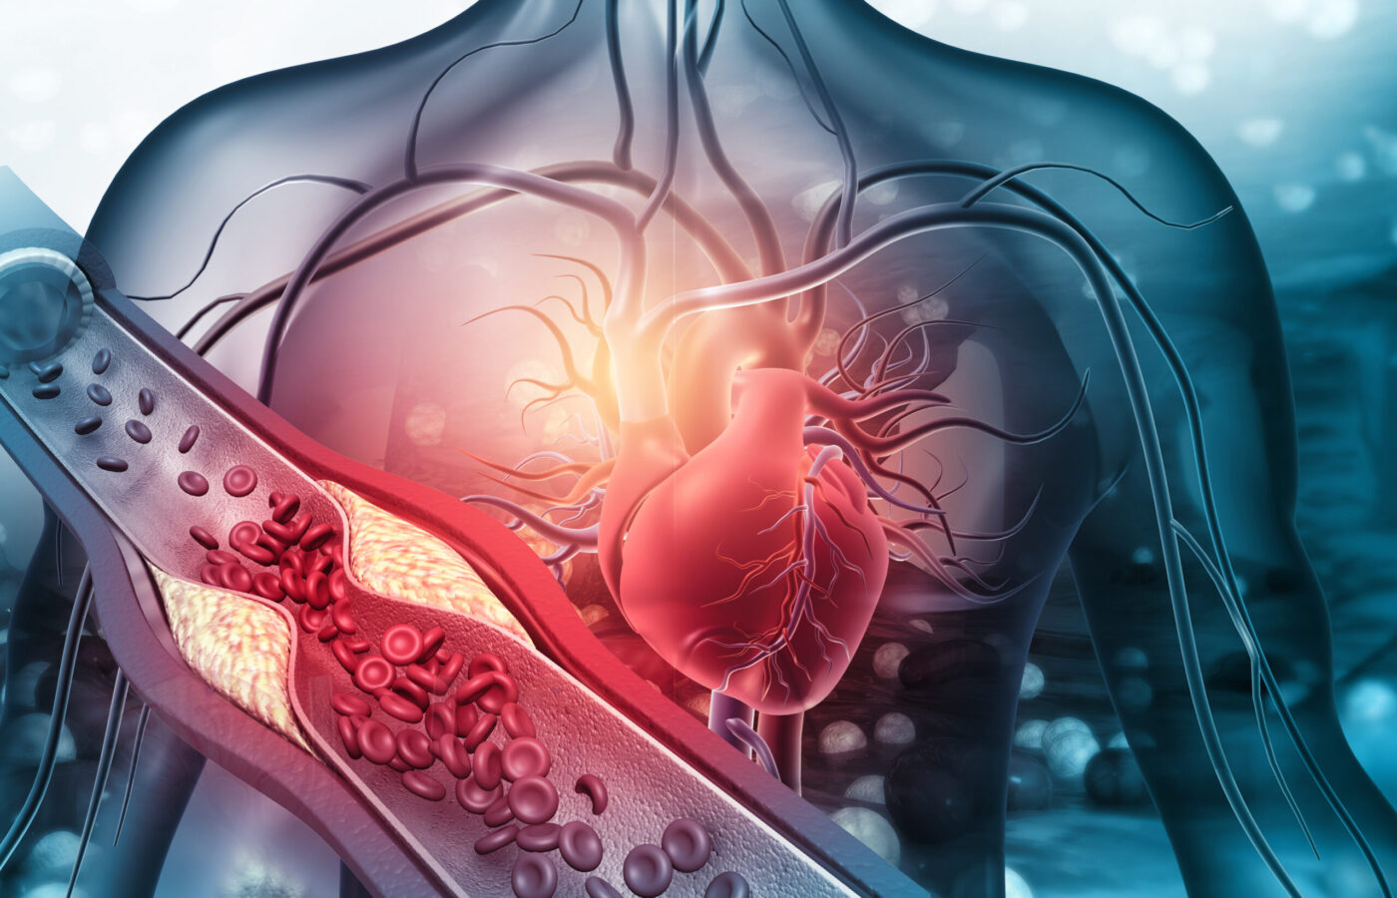
Introduction:
Heart disease is one the major cause of morbidity and mortality globally. A heart attack happens when the flow of oxygen-rich blood to a section of heart muscle suddenly becomes blocked and the heart can’t get oxygen. If blood flow isn’t restored quickly, the section of heart muscle begins to die.
Doctors and Scientists across the globe have started to look into Machine Learning Techniques to develop screening tools.
In this project, we shall be giving you a walk through on the development of a screening tool for predicting whether a patient has a 10-year risk of developing coronary heart disease (CHD) based on their present health conditions using different Machine Learning Techniques.

Slide 4

Problem Statement:
The dataset is from an ongoing cardiovascular study on residents of the town of Framingham, Massachusetts. The classification goal is to predict whether the patient has a 10-year risk of future coronary heart disease (CHD). The dataset provides the patient's information. It includes over 3990 records and 16 attributes.

Slide 5
Data Analysis Steps:
Imported Libraries
In this part, we imported the required libraries NumPy, Pandas, matplotlib, and seaborn, to perform Exploratory Data Analysis and for prediction, we imported the Scikit learn library.
Descriptive Statistics
In this part, we start by looking at descriptive statistic parameters for the dataset. We will use describe() this told mean, median, standard deviation
Missing Value Imputation
We will now check for missing values in our dataset. after checking not existed any missing values, In case there are any missing entries, we will impute them with appropriate values.
Graphical Representation
We will start with Univariate Analysis, bivariate Analysis and conclude with various prediction models helps us predict the Risk.

Slide 6
Attributes of each variable:
Demographic:
▪ Sex: male or female("M" or "F")
▪ Age: Age of the patient;(Continuous - Although the recorded ages have been truncated to whole numbers, the concept of age is continuous)
Behavioral:
▪ is_smoking: whether or not the patient is a current smoker ("YES" or "NO")
▪ Cigs Per Day: the number of cigarettes that the person smoked on average in one day.(can be considered continuous as one can have any number of cigarettes, even half a cigarette.)
Medical( history):
▪ BP Meds: whether or not the patient was on blood pressure medication (Nominal)
▪ Prevalent Stroke: whether or not the patient had previously had a stroke (Nominal)
▪ Prevalent Hyp: whether or not the patient was hypertensive (Nominal)
▪ Diabetes: whether or not the patient had diabetes (Nominal) DATA DESCRIPTION

Slide 7
Medical( Current):
▪ Tot Chol: total cholesterol level (Continuous)
▪ Sys BP: systolic blood pressure (Continuous)
▪ Dia BP: diastolic blood pressure (Continuous)
▪ BMI: Body Mass Index (Continuous)
▪ Heart Rate: heart rate (Continuous - In medical research, variables such as heart rate though in fact discrete, yet are considered continuous because of large number of possible values.)
▪ Glucose: glucose level (Continuous)
Predict variable (desired target):
▪ 10-year risk of coronary heart disease CHD(binary: “1”, means “Yes”, “0” means “No”) - D

Slide 8
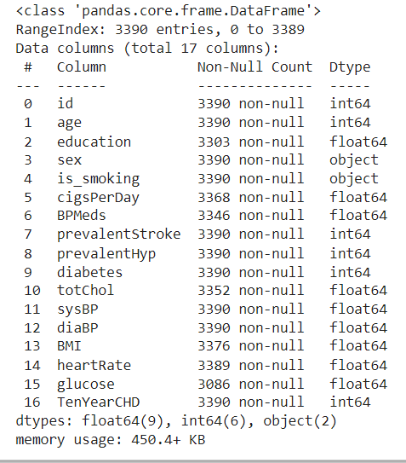
Data Inspection:
This Dataset has contains 3390 rows and 16 columns.
Six categorical features i.e sex and is_smoking,BPMeds,prevalentStroke,prevalent Hyp,diabetes.
This Dataset also contain missing values around 510 of seven features.

Slide 9
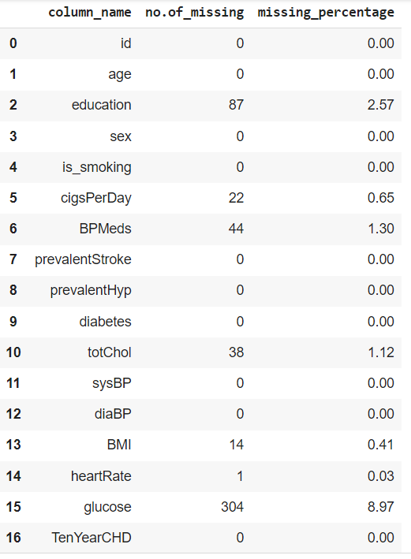
Data Inspection(Missing Values and Percentage):

Slide 10
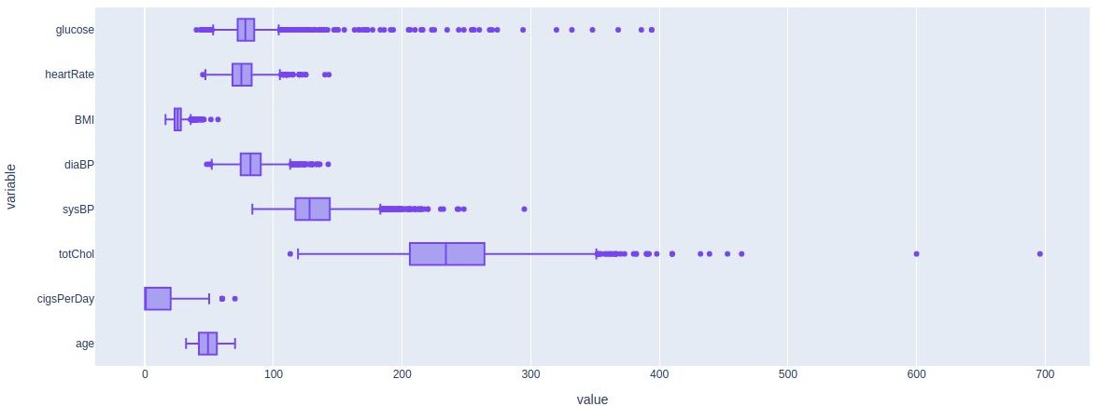
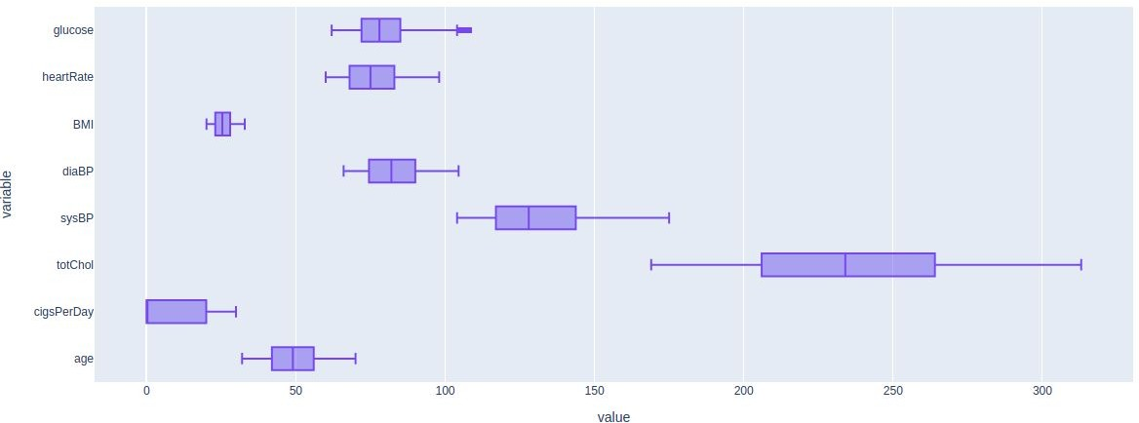
Analysis Of Outliers:
Age has no outlier.
Capping the outlier rows with Percentile.

Slide 11
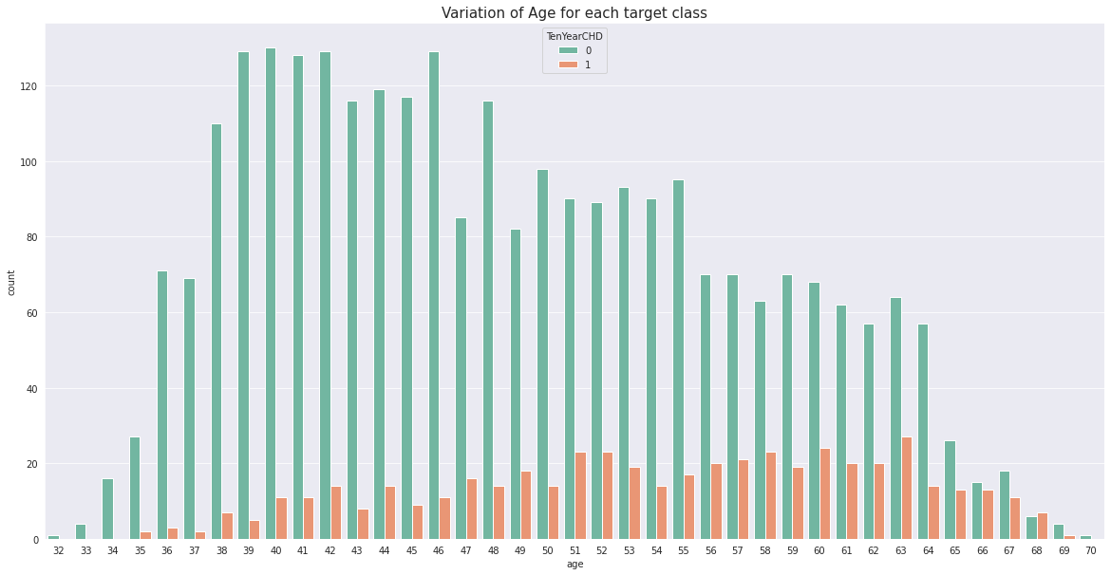
Analysis Of Age for each Target class:
Coronary heart disease(CHD) increases after age 51.
Age group (34 < Age < 51) are at lower risk of cardiovascular disease.

Slide 12
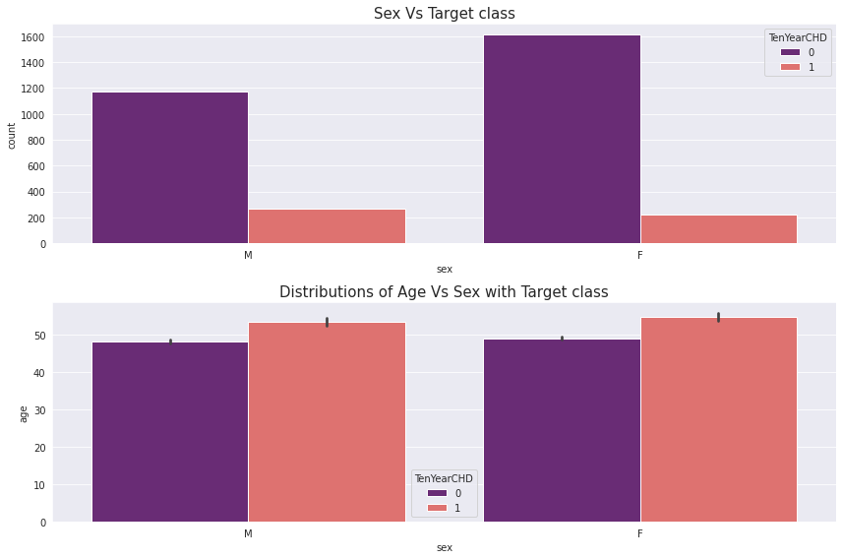
Analysis Of Age vs Sex with Target class :
As we can see the countplot we can say that no. of male heart patient more than female.
As we can see the barplot we can say that male get early CHD as compared to female.

Slide 13
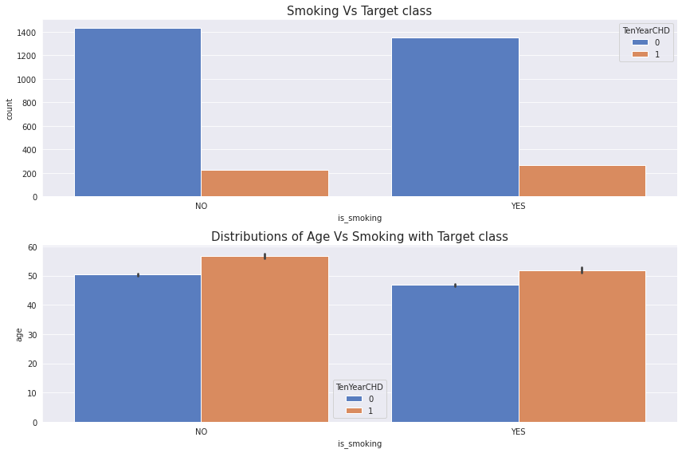
Analysis Of Age vs Smoking with Target class :
As we can see the countplot we can say that no. of patient those who smoke more than as compared to those who won’t.
As we can see the barplot we can say that those who smoke get early heart disease as compared to those who won’t.

Slide 14
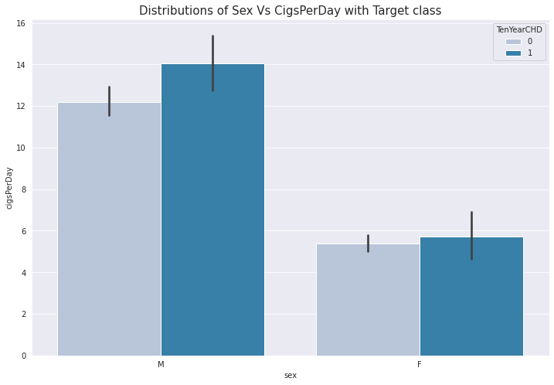
Analysis Of Cigs per day vs Sex with Target class :
As we can see the barplot we can say that no. of cigsperday taken by male is more than female.
So, male heart patient is more as compared to female.
In case of male CHD = 1 when he take cigsperday > 12.1 and in case of female CHD = 1 when she take cigsperday > 4.8.

Slide 15
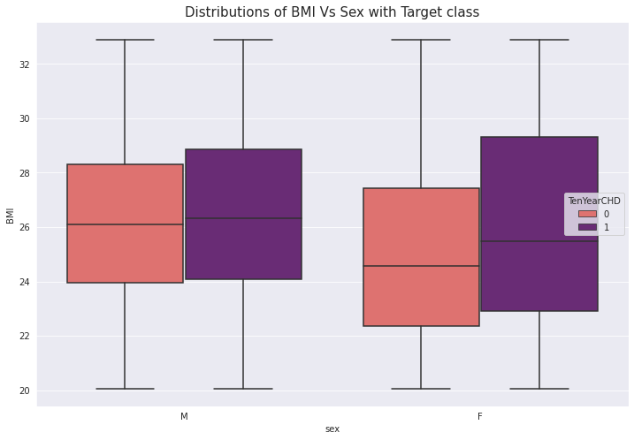
Analysis Of BMI vs Sex with Target class :
As we can see the boxplot we can say
that female BMI is more than male BMI. that’s leads to OVERWEIGHT.
So,female CHD patient more than male CHD patient.
If your BMI is:
below 18.5 – you're in the underweight range
between 18.5 and 24.9 – you're in the healthy weight range
between 25 and 29.9 – you're in the overweight range
between 30 and 39.9 – you're in the obese range

Slide 16
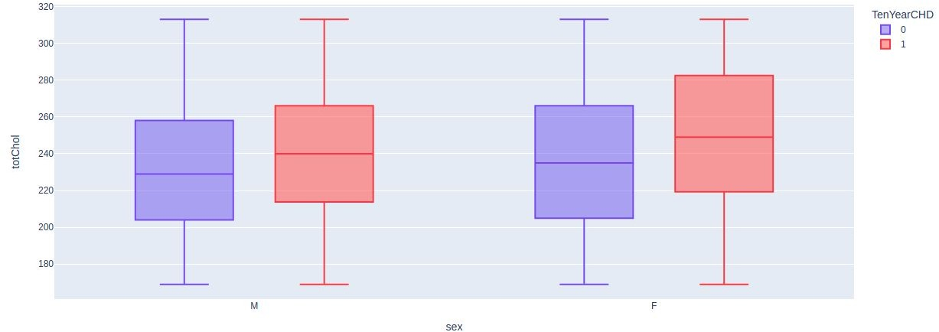
Analysis Of Cholesterol vs Sex withTarget class :
As we can see the boxplot we can say that female cholesterol is more than male cholesterol that’s leads to OVERWEIGHT.
So, In female heart disease is more due to cholesterol.

Slide 17
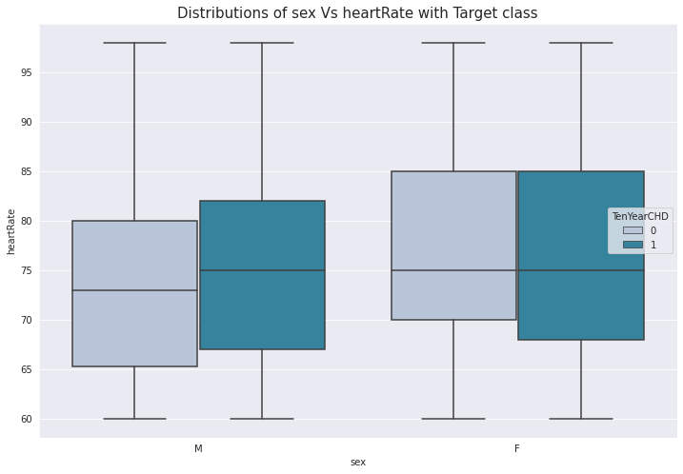
Analysis Of Heart Rate vs Sex with Target class :
As we can see the box plot we can say that for Female heart disease patients has more Heart Rate as compared to male heart disease patients.

Slide 18
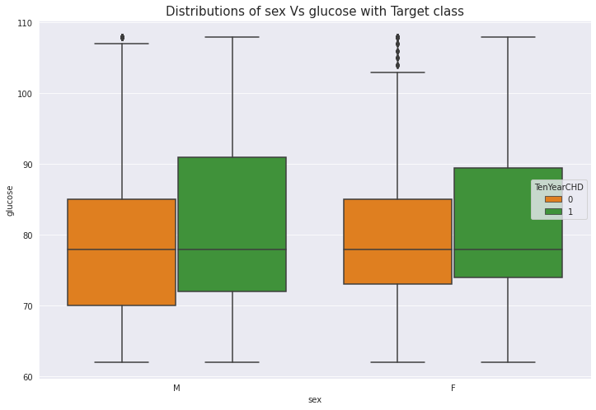
Analysis Of Glucose vs Sex with Target class :
As we can see the box plot we can say that for male heart disease patients has more glucose level as compared to female heart disease patients.

Slide 19
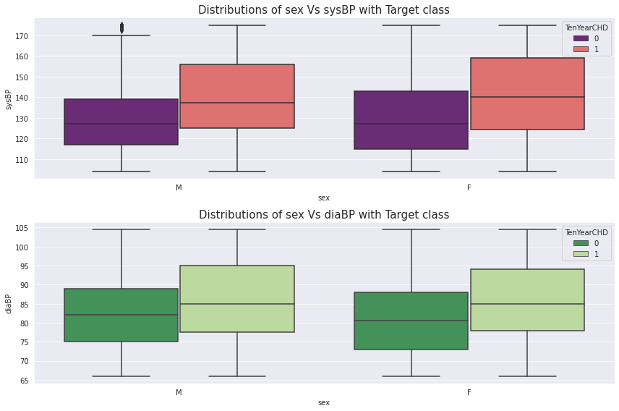
Analysis Of Systolic and Diastolic vs Sex with Target class :
As we can see the box plot we can say that for female heart disease patients has more Systolic BP level as compared to male heart disease patients.
Normal < 120 mmHg.
As we can see the box plot we can say that for male heart disease patients has more Diastolic BP level as compared to female heart disease patients.
Normal < 80 mmHg.

Slide 20
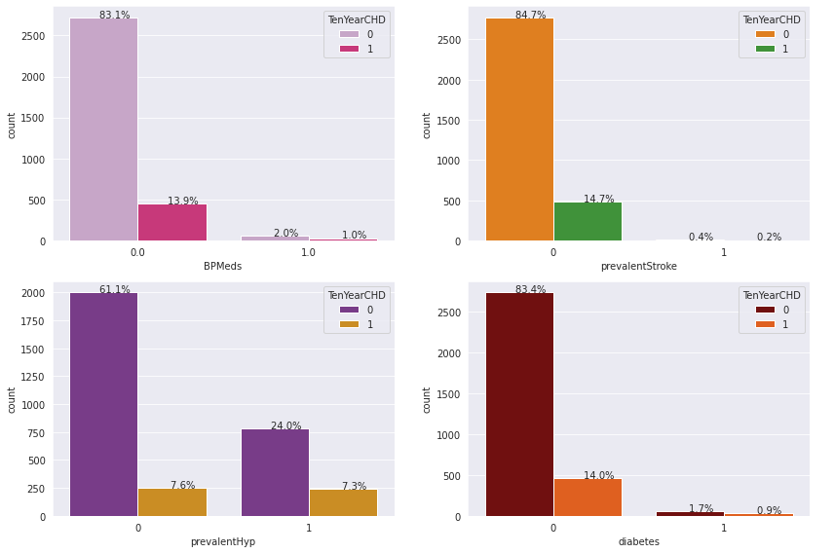
Analysis Of BP Meds | PrevalentStroke | PrevalentHyp | Diabetes vs Sex with Target class :
BPMeds means whether or not the patient was on blood pressure medication i.e if the patients is take medication then it reduces the risk of heart disease, as compared to who won't take medication.

Slide 21
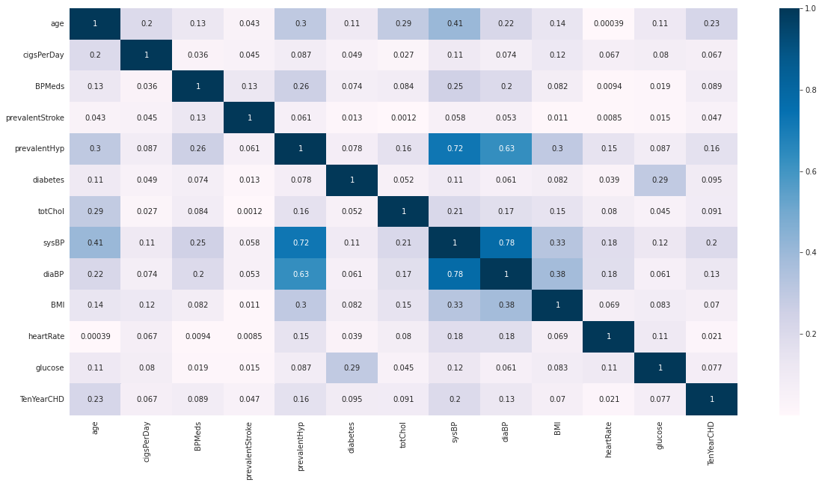
Correlation matrix:
sysBP is moderately correlated with prevalenthyp, i.e. prevalent hypertension.
diaBP and sysBP are somewhat moderately correlated.
glucose level are also moderately correlated to whether patient is diabetic.

Slide 22
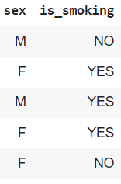
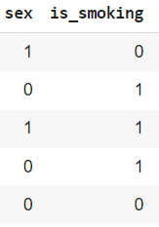
Label Encoding:
We have two categorical columns i.e sex and is_smoking.
After applying label encoding we converted into 0’s and 1’s.

Slide 23
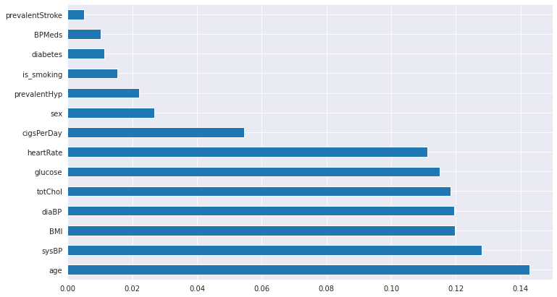
Feature Selection:
For feature selection we used ExtraTreeClassifiers.
We found that every features are important.

Slide 24
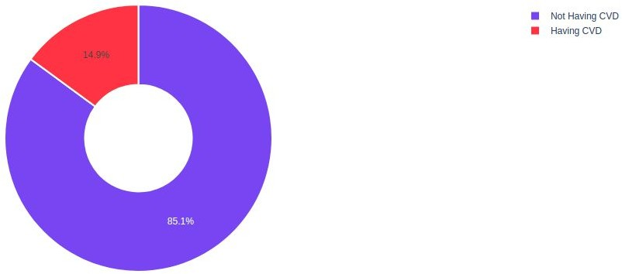

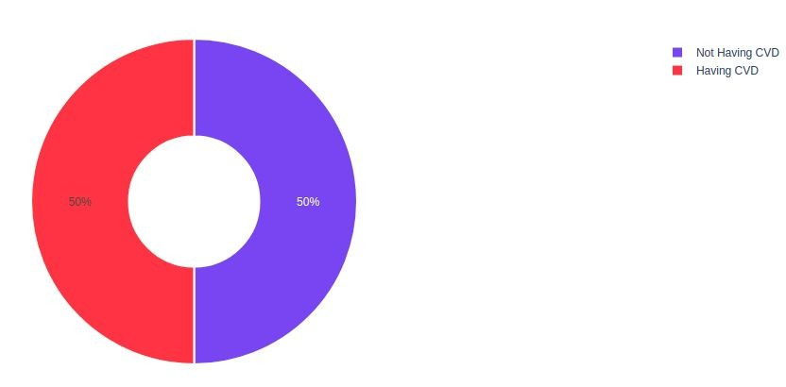

Handling Imbalanced Data:
SMOTE
SMOTE (Synthetic Minority Oversampling Technique) works by randomly picking a point from the minority class and computing the k-nearest neighbors for this point. The synthetic points are added between the chosen point and its neighbors.

Slide 25

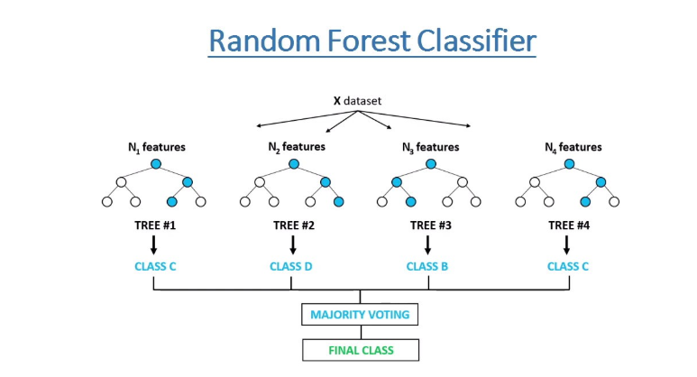
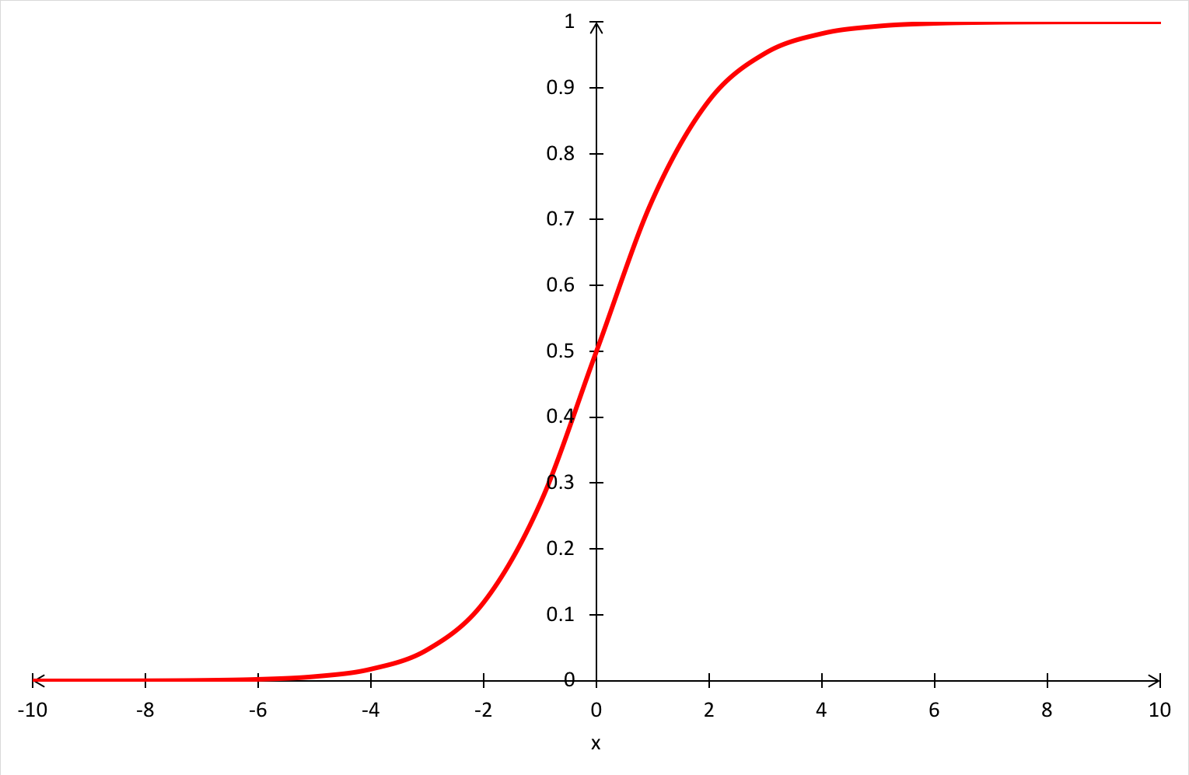
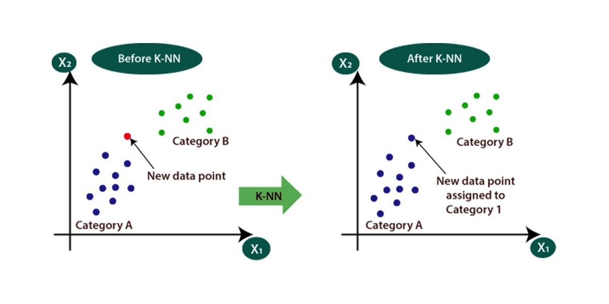
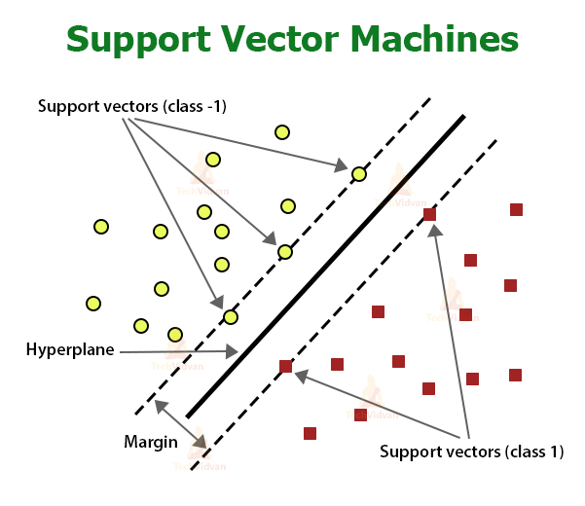
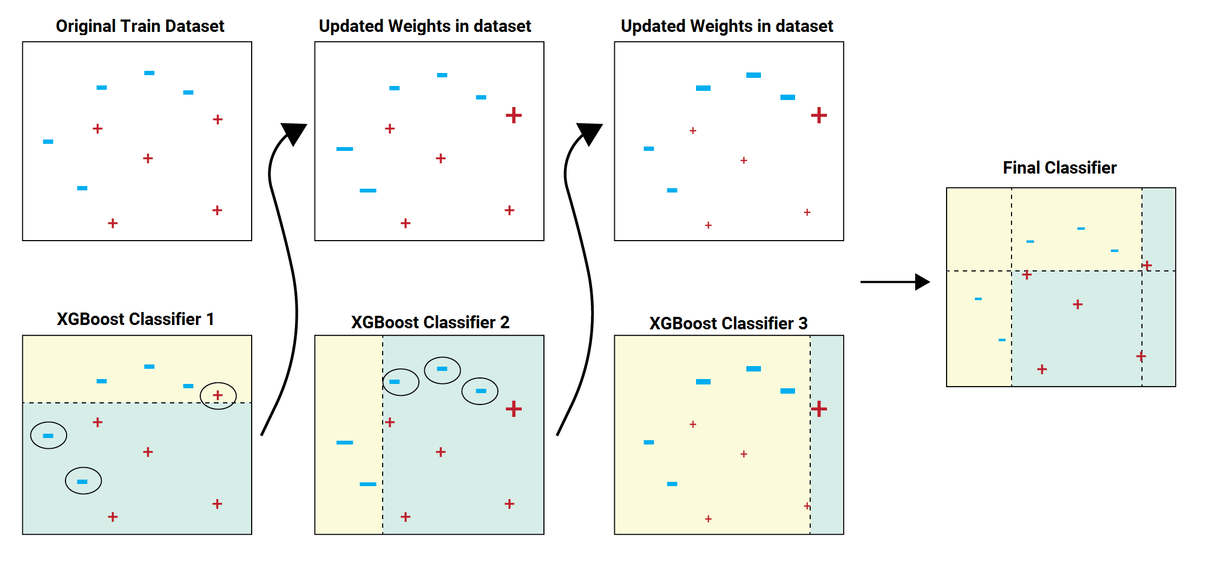
Model Building:
1] Logistic Regression 2] Decision Tree Classifier 3] Random Forest Classifier
4] XGB Classifier 5] KNN Classifier 6] Support Vector Machines

Slide 26
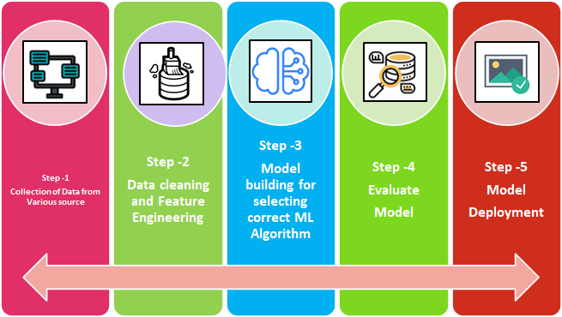
Machine Learning Process Flow:

Slide 27
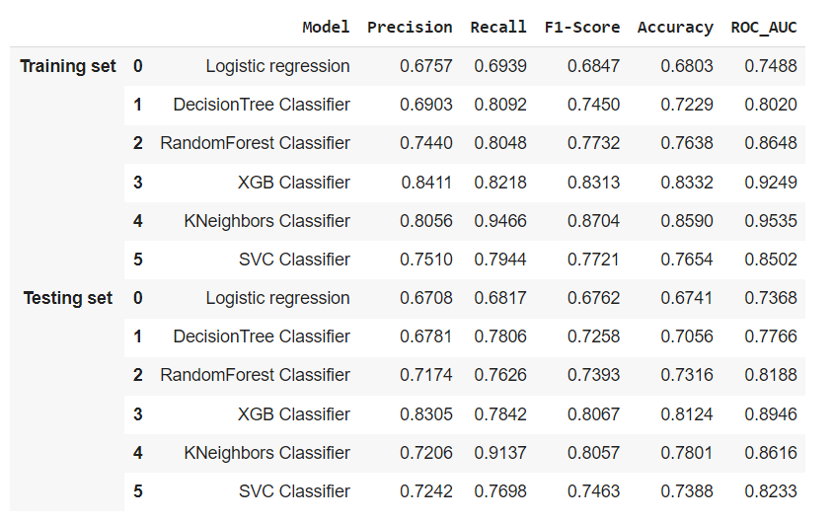
Evaluating models:

Slide 28
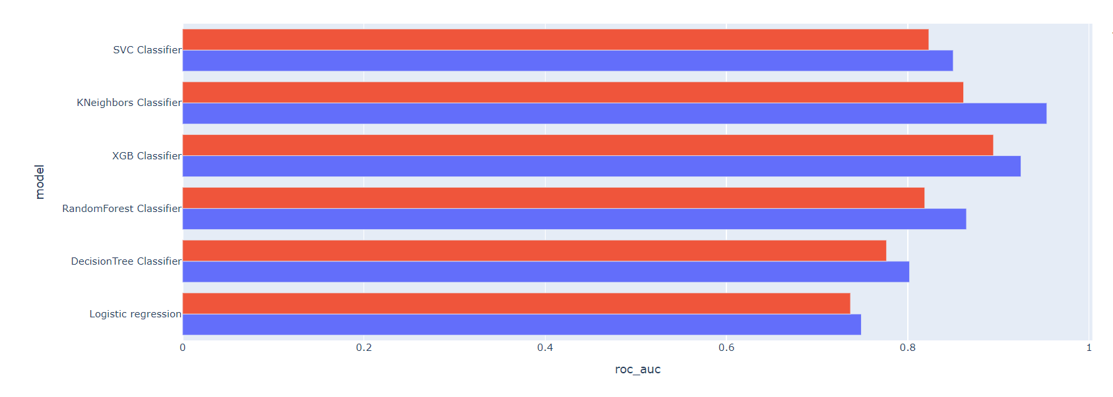
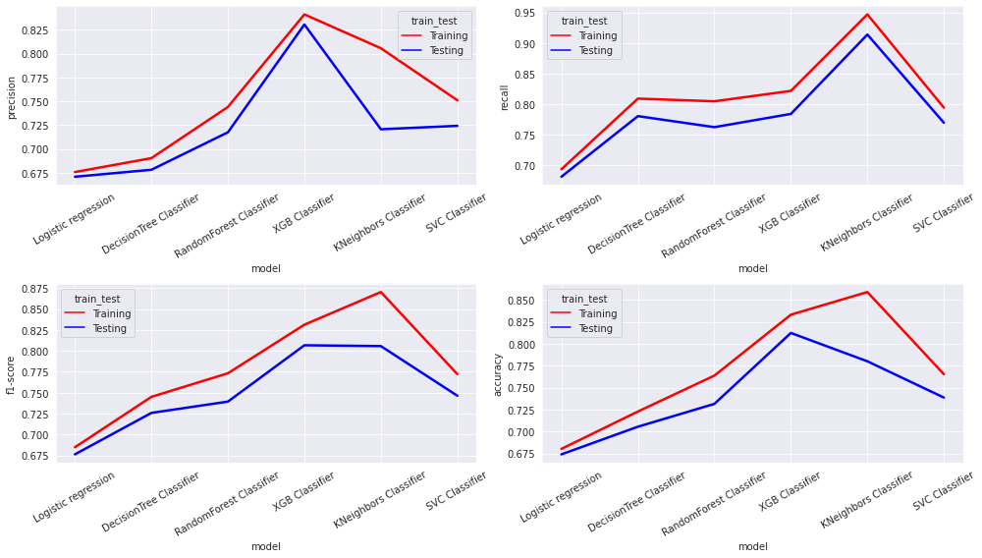
Comparing different ML Models:
In the above Models Evaluation Table(Testing set) our auc-roc score is more than 0.80 except Logistic regression and Decision Tree.So we can say that our model predicted the classes in a good manner.
XGB Classifier is performing well which has best Recall,Precision,F1-Score and Accuracy Score.

Slide 29
Challenges:
Large Dataset to handle
Needs to plot lot of Graphs to analyse
Handling Null values
Feature selection
Optimising the model
Carefully tuned Hyperparameters

Slide 30
Conclusion:
In the given dataset we observe that Coronary heart disease increases from age 51 to 67 then decreases.
We draw the countplot and observe that no. of male heart patients is more than female and also notice that male get early age heart diseases as compared to females.
We observe no. of heart patients who smoke more than as compared to those who won’t and also notice that those who smoke get early heart disease as compared to those who won’t.
We draw the barplot and observe that no. of cigsperday taken by male is more than female.So, male heart patients is more as compared to females.
We draw the boxplot and observe that female BMI(The BMI is defined as the body mass divided by the square of the body height, and is expressed in units of kg/m²) is more than male BMI. that’s leads to OVERWEIGHT and So,female CHD patients is more than male CHD patients.

Slide 31
We draw the boxplot and observe that female Cholesterol is more than male Cholesterol. that’s leads to OVERWEIGHT and So, in that case also female CHD patients is more than male CHD patients.
We Observe that Female heart disease patients has more Heart Rate as compared to male heart disease patients.
We also observe that male heart disease patients has more glucose level as compared to female heart disease patients.
In the Models Evaluation Table(Testing set) our auc-roc score is more 0.80 except Logistic regression and Decision Tree.So we can say that our model predicted the classes in a good manner.
XGBClassifier are performing well which has the best Recall,Precision,F1-Score and Accuracy Score.

Slide 32


